Slide 1
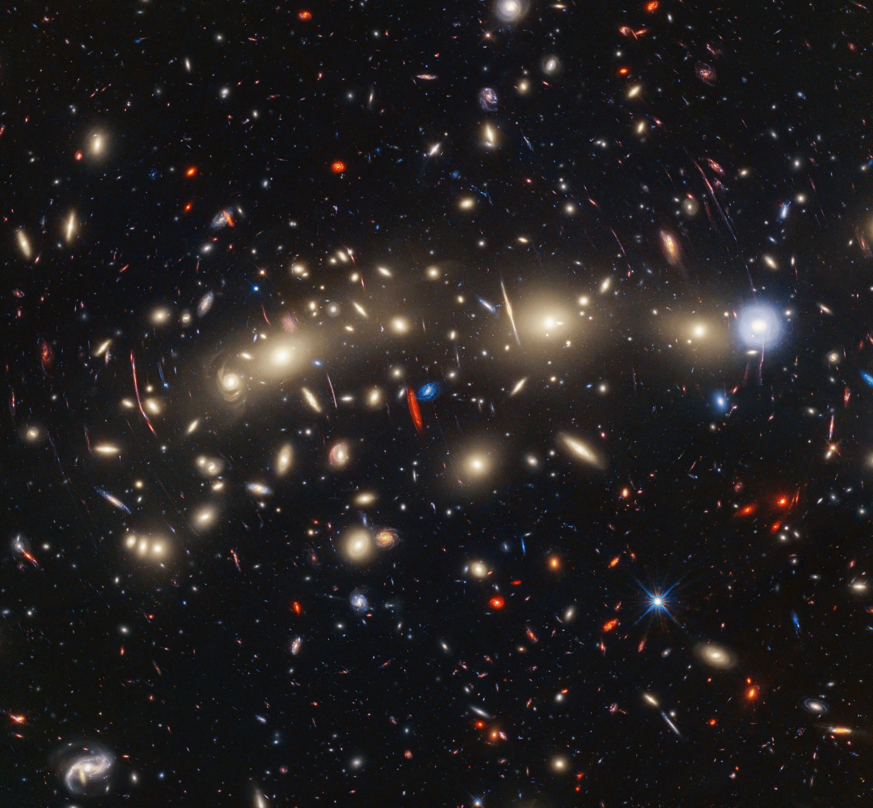



R. Honor
Mentor: Dr. Rogier Windhorst
SKYSURFIR
School of Earth and Space Exploration, ASU
AZSGC Symposium
April 19, 2025
Catching Light Waves

Slide 2

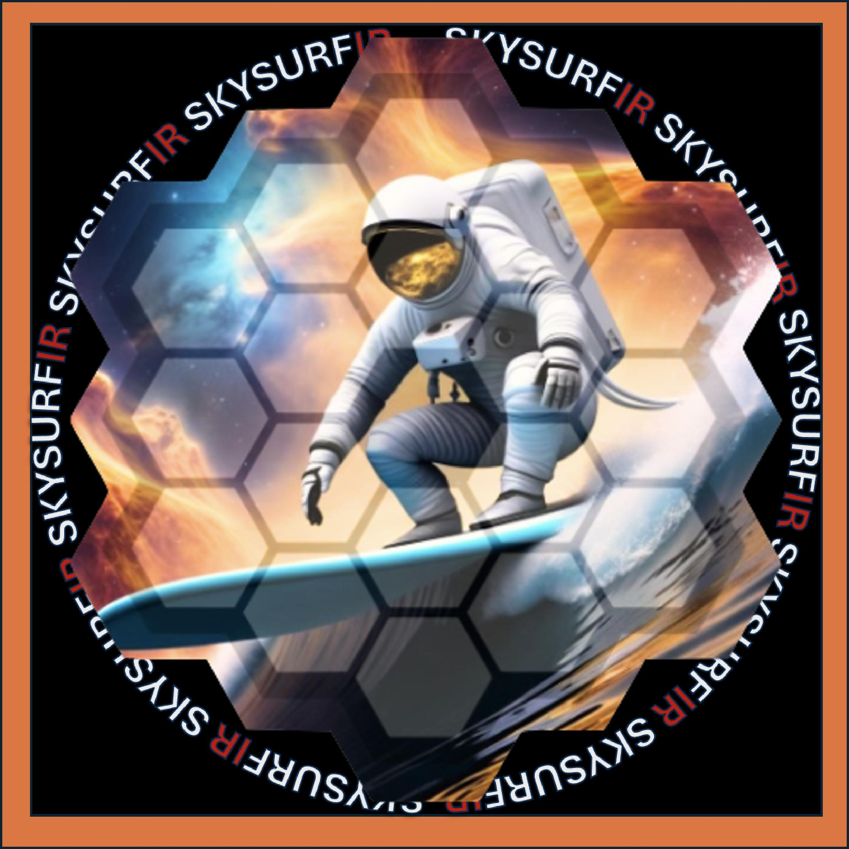
Introduction to SKYSURFIR
Follow up to Project SKYSURF (HST data) using JWST NIRCam and NIRISS data
Goal is to measure and categorize the different types of background light to optimize these telescopes
SKYSURFIR will measure the sky-SB across ~60,000 exposures observed with JWST
+ IR =

Slide 3
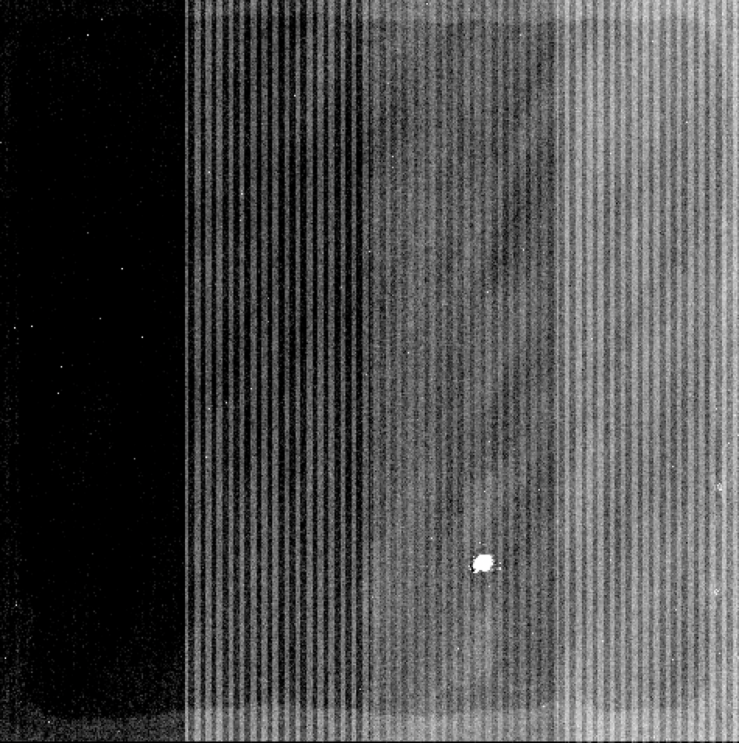
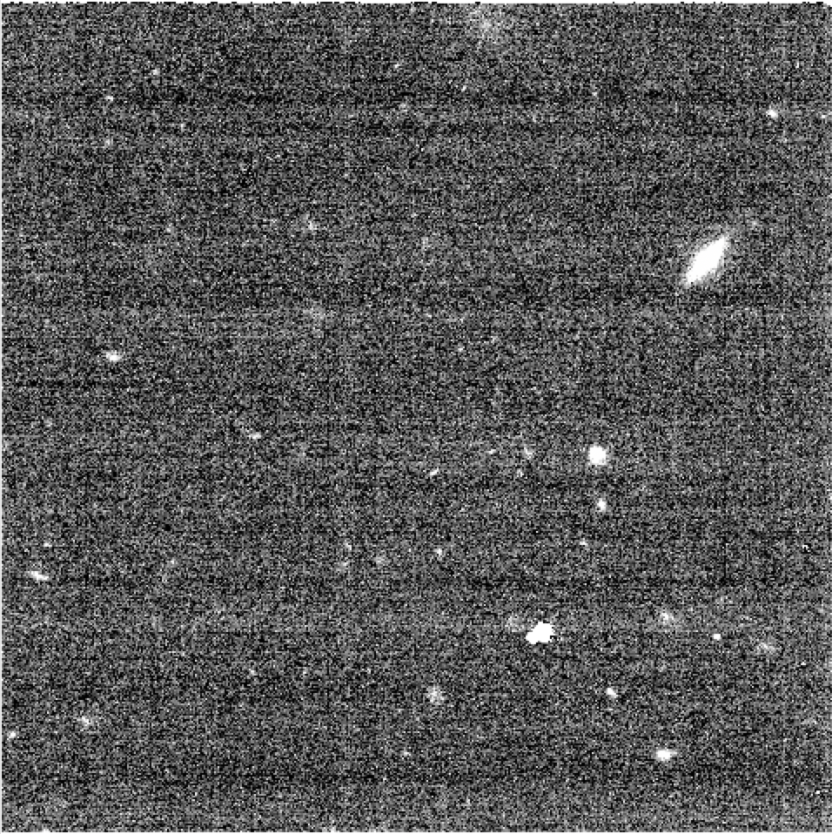
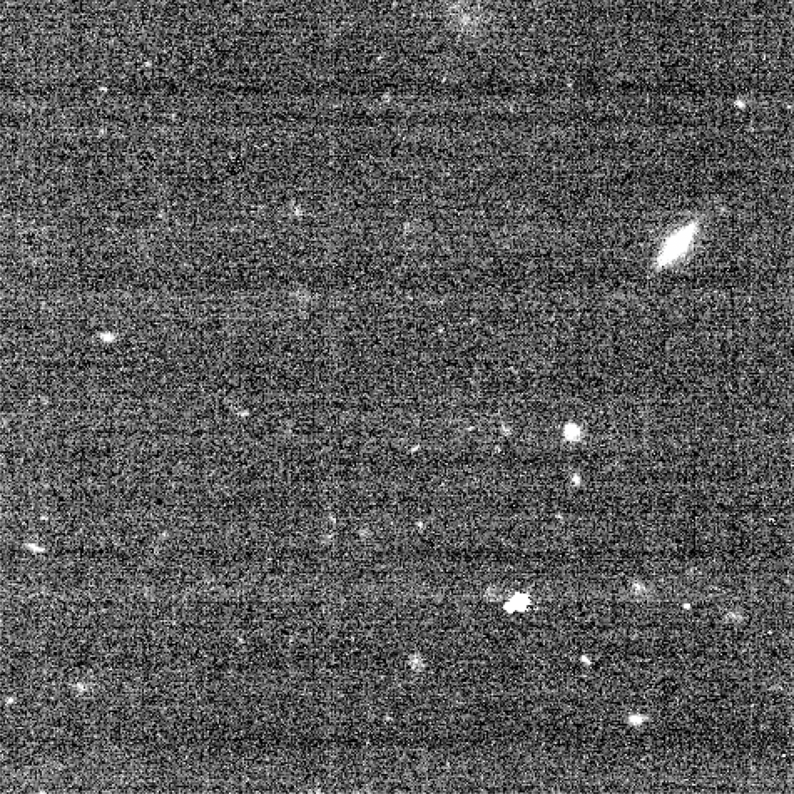
JWST Image Calibration Pipeline
uncal
rate
cal
Raw data downloaded from MAST (the Mikulski Archive for Space Telescopes)
Has dark current corrections, bad pixels flagged, and jumps in the ramp caused by cosmic rays identified
Final image with ramps fully calibrated

Slide 4
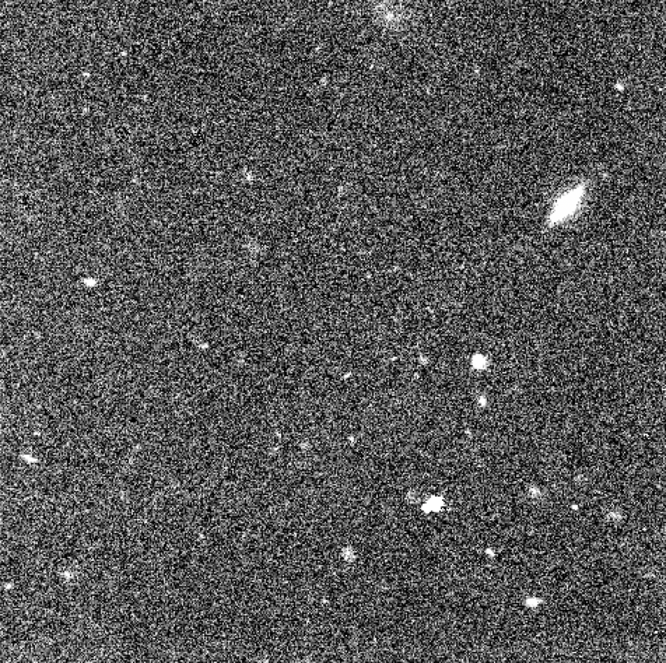
1/f Removal
cal with 1/f noise
cal without 1/f noise
1/f noise is frequency-dependent striping signal caused by electronics which appears in a variety of settings but is of unknown origin
This shows up as bands in our images and can affect sky-SB measurement
We can use algorithms to subtract the 1/f noise from JWST images

Slide 5
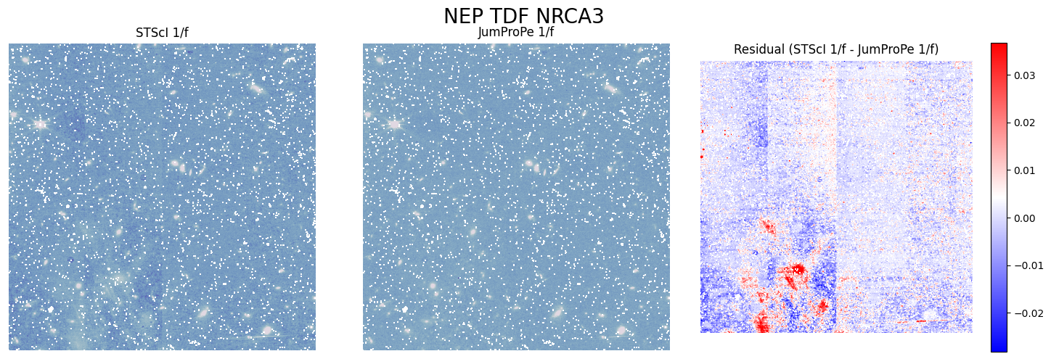
1/f Subtraction Methods
STScI Pipeline
JUMPROPE
Residual (STScI−JUMPROPE)
STScI has a 1/f removal algorithm built into the pipeline
JUMPROPE is another algorithm that subtracts 1/f noise from JWST images
We opted to use JUMPROPE because the STScI version tends to oversubtract

Slide 6
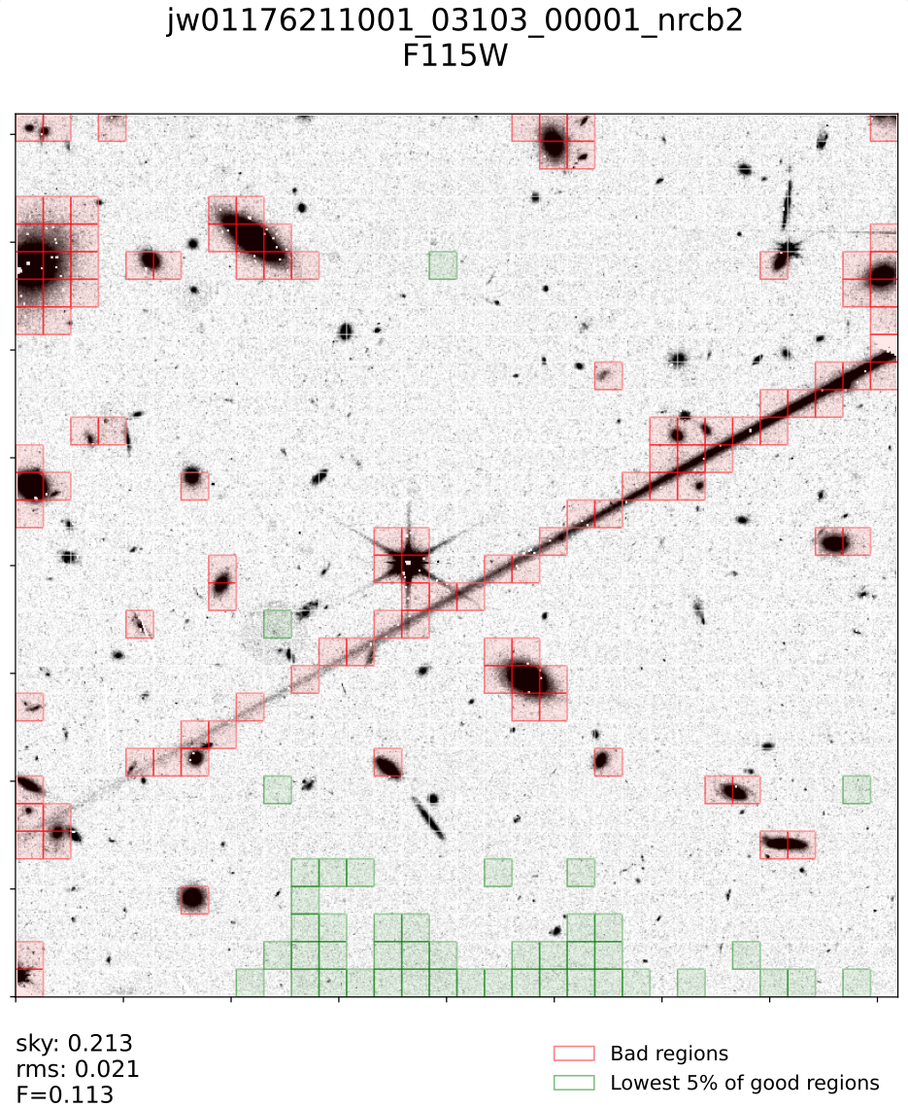
Measuring Sky-SB
Once we run the pipeline and JUMPROPE, we can measure the sky-SB
We use an algorithm to flag good and bad regions of the image
Bad regions are those which contain bright objects
We select the darkest 5% of good regions to measure the sky-SB in
(colors are inverted in this image)

Slide 7
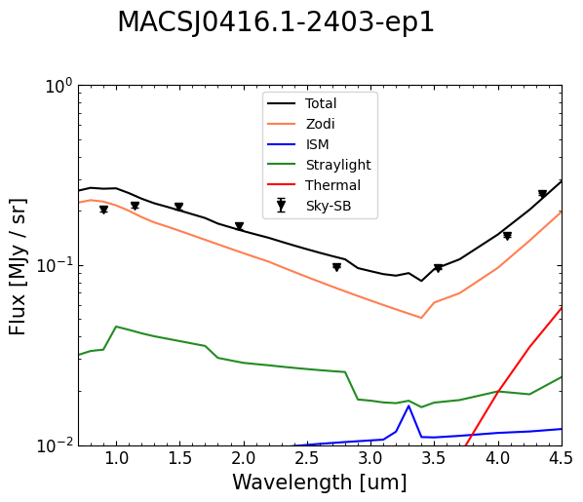
Results From Measuring Sky-SB
We measure the background light and separate it into the following categories:
  Zodiacal Light – light from within the inner solar system
  ISM – Interstellar Medium (gas, dust, cosmic rays, etc.)
  Straylight – light from objects outside the FOV that still ends up in the image
  Thermal – heat (IR light) from the telescope itself

Slide 8
Conclusion & Next Steps
Over the course of several months, we calibrated nearly 60,000 individual JWST exposures using STScI's pipeline and performed 1/f subtraction and wisp removal on them using JUMPROPE
We are currently in the process of measuring the sky-SB of all these images
Preliminary results show a discrepancy between the amount of background light we measure and the amount predicted by our models, which supports what was found in Project SKYSURF
Our Zodi model could be missing a spherical component
We will continue to improve our models in order to optimize the use of these space telescopes

Slide 9
Acknowledgements
Dr. Rogier Windhorst, Dr. Seth Cohen, Dr. Timothy Carleton, Ralph Ortiz, Rosalia O'Brien, and the rest of the SKYSURFIR team
Jordan D'Silva (JUMPROPE)
Space Telescope Science Institute
The Arizona NASA Space Grant Consortium

Slide 10
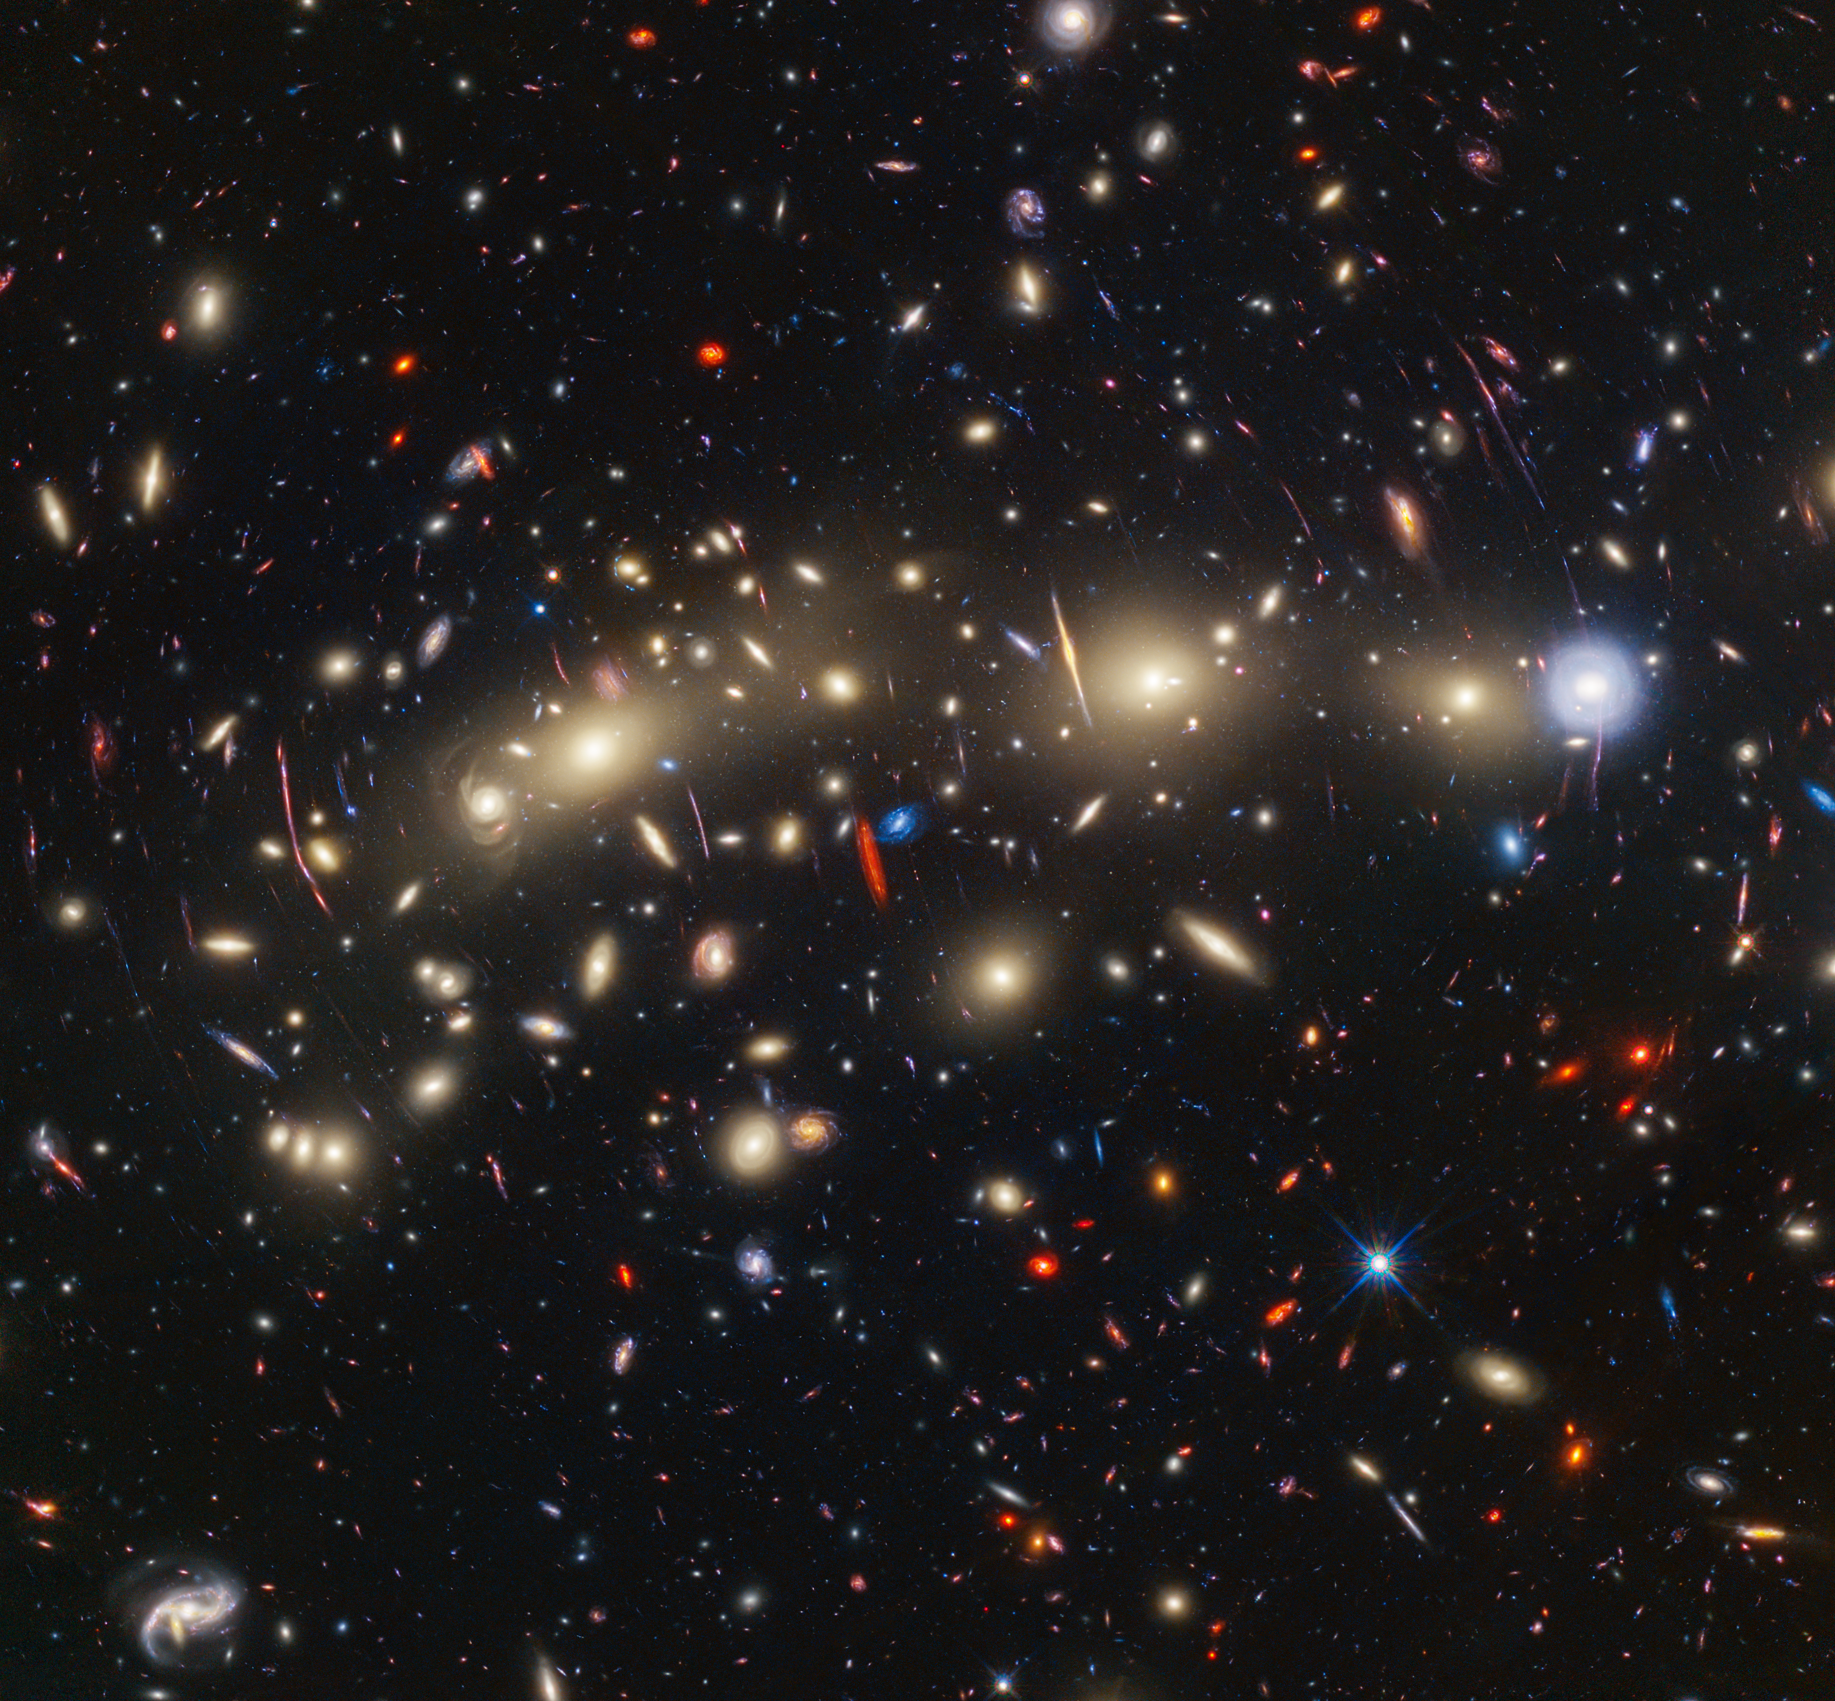
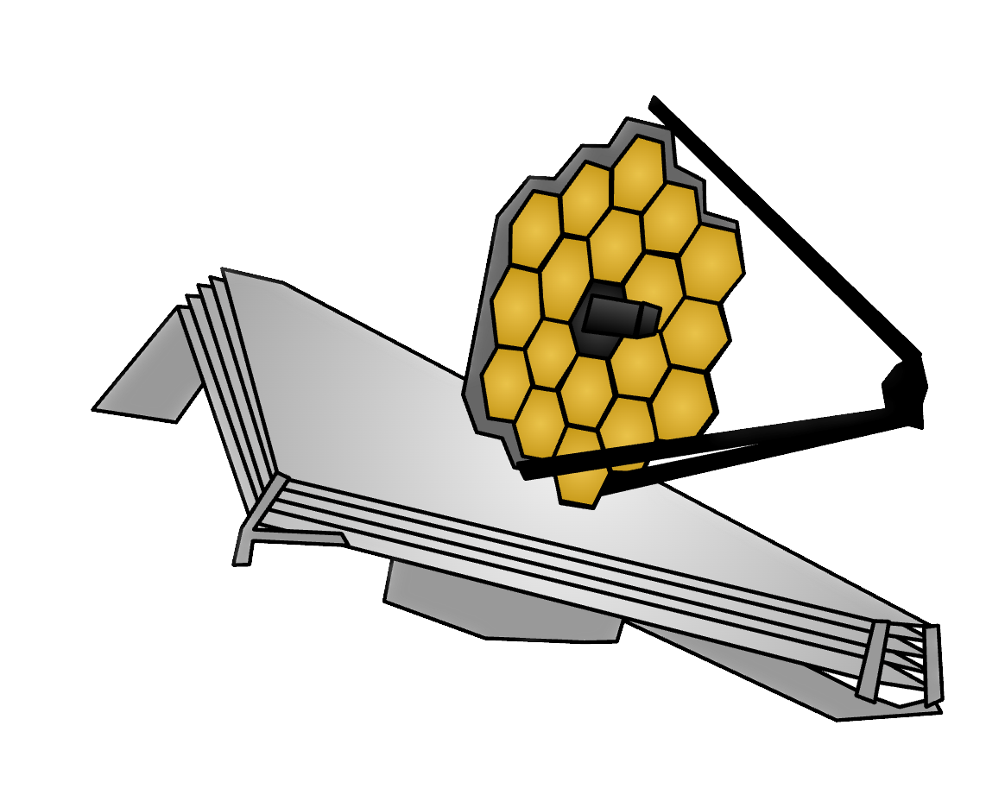
Thank you!
rchonor@asu.edu

